Slide 1
Ensemble Learning
Dr. Sugata Ghosal
sugata.ghosal@pilani.bits-pilani.ac.in

Slide 2
Text Book(s)
T1 | Christopher Bishop: Pattern Recognition and Machine Learning, Springer International Edition
T2 | Tom M. Mitchell: Machine Learning, The McGraw-Hill Companies, Inc..
These slides are prepared by the instructor, with grateful acknowledgement of Prof. Tom Mitchell, Prof.. Burges, Prof. Andrew Moore and many others who made their course materials freely available online.

Slide 3
Contents
Combining classifiers
Bagging
Boosting
Random Forest Algorithm
AdaBoost Algorithm
Gradient Boosting

Slide 4
Getting Started
No Free Lunch Theorem: There is no algorithm that is always the most accurate
Each learning algorithm dictates a certain model that comes with a set of assumptions
Each algorithm converges to a different solution and fails under different circumstances
The best tuned learners could miss some examples and there could be other learners which works better on (may be only) those !
In the absence of a single expert ( a superior model ) , a committee (combinations of models) can do better !
A committee can work in many ways ...

Slide 5
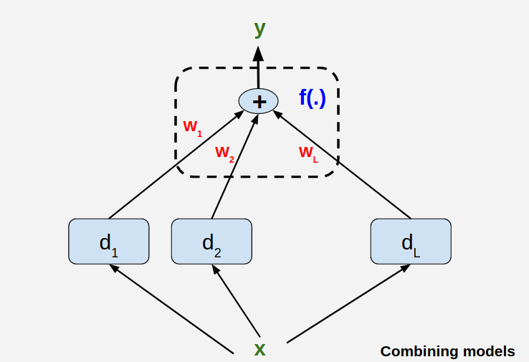
Committee of Models
Committee Members are base learners !
Major challenges dealing with this committee
Expertise of each of the members (Does it help / not?)
Combining the results from the members for better performance

Slide 6
Ensemble Methods
Ensemble methods use multiple learning algorithms to obtain better predictive performance than could be obtained from any of the constituent learning algorithms alone
Construct a set of classifiers from the training data
Predict class label of test records by combining the predictions made by multiple classifiers
Tend to reduce problems related to over-fitting of the training data.

Slide 7
General Approach

Slide 8
Issue 1 : On the members ( Base Learners )
It does not help if all learners are good/bad at roughly same thing
Need Diverse Learners

Slide 9
Issue 1 : On the members ( Base Learners )
Use Different Algorithms
Different algorithms make different assumptions
Use Different Hyperparameters, that is ,
vary the structure of neural nets

Slide 10
Issue 1 : On the members ( Base Learners )
Different input representations
Uttered words + video information of speakers clips
image + text annotations
Different training sets
Draw different random samples of data
Partition data in the input space and have learners specialized in those spaces (mixture of experts)

Slide 11
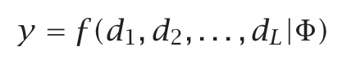
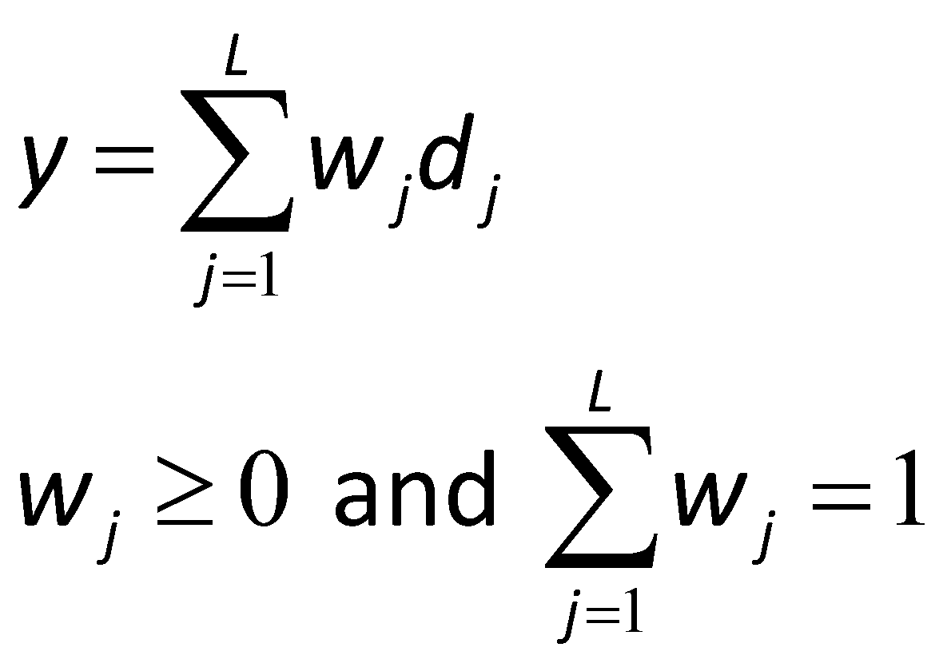
Issue -2 : Combining Results Base Learners
A Simple Combination Scheme:

Slide 12
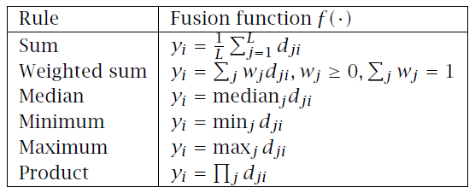
Issue -2 : Combining Results Base Learners

Slide 13
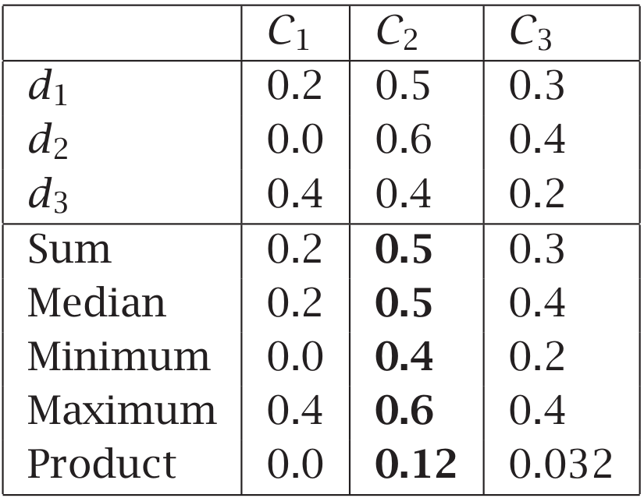
Issue -2 : Combining Results Base Learners

Slide 14
When does Ensemble work?
Ensemble classifier performs better than the base classifiers when error rate is smaller than 0.5
Necessary conditions for an ensemble classifier to perform better than a single classifier:
Base classifiers should be independent of each other
Base classifiers should do better than a classifier that performs random guessing

Slide 15
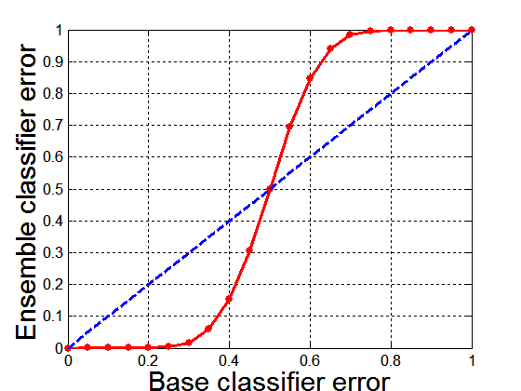
Why Ensemble Methods work?
25 base classifiers
Each classifier has error rate, ε = 0.35
If base classifiers are identical, then the ensemble will misclassify the same examples predicted incorrectly by the base classifiers depicted by dotted line
Assume errors made by classifiers are uncorrelated
Ensemble makes a wrong prediction only if base classifiers error is more than 0.5

Slide 16








Majority Vote Classifier
Training set
New data
Classification models
h₁
h₂
. . .
h_{n}
Predictions
y₁
. . .
y_{n}
y₂
Voting
Final prediction
y_{f}
y_{f}̂ = mode{h₁(x), h₂(x), . . . h_{n}(x)}
where h_{i}(x) = y_{i}
Sebastian Raschka

Slide 17
Why Majority Vote?
assume n independent classifiers with a base error
ϵ
rate
here, independent means that the errors are uncorrelated
assume a binary classification task
assume the error rate is better than random guessing (i.e., lower than 0.5 for binary classification)
∀ϵ_{i} ∈ {ϵ₁, ϵ₂, . . . , ϵ_{n}}, ϵ_{i} < 0.5
Sebastian Raschka

Slide 18
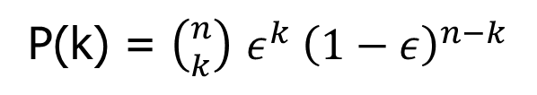
Why Majority Vote?
assume n independent classifiers with a base error rate ϵ
here, independent means that the errors are uncorrelated
assume a binary classification task
assume the error rate is better than random guessing (i.e., lower than 0.5 for binary classification)
∀ϵ_{i} ∈ {ϵ₁, ϵ₂, . . . , ϵ_{n}}, ϵ_{i} < 0.5
The probability that we make a wrong prediction via the ensemble if k classifiers predict the same class label
P(k) = $\left({n \atop k}\right)$ $ε^{k} {\left(1−ε\right)}^{n−k}$
k > ⌈n/2⌉
(Probability mass func. of a binomial distr.)
Sebastian Raschka

Slide 19
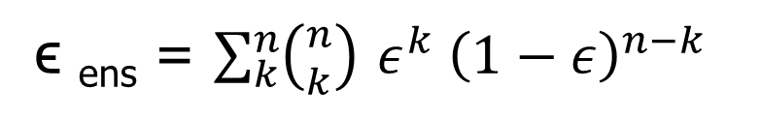
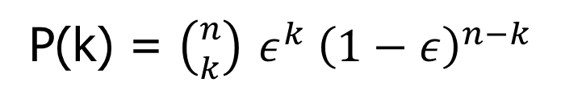
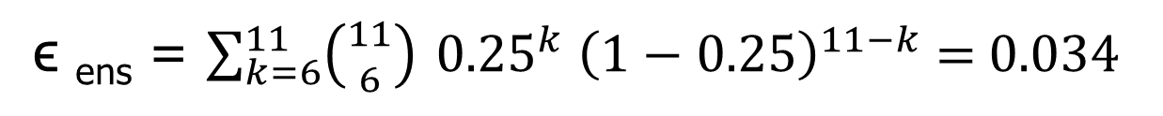
Why Majority Vote?
The probability that we make a wrong prediction via the ensemble if k classifiers predict the same class label
P(k) = $\left({n \atop k}\right)$ $ε^{k} {\left(1−ε\right)}^{n−k}$
k > ⌈n/2⌉
Ensemble error:
ϵ _{ens} = $\sum_{k}^{n}{\left({n \atop k}\right) ε^{k} {\left(1−ε\right)}^{n−k} }$
ϵ _{ens} = $\sum_{k=6}^{11}{\left({11 \atop 6}\right) {0.25}^{k} {\left(1−0.25\right)}^{11−k} \text{= }\text{0.034 }}$
Sebastian Raschka

Slide 20
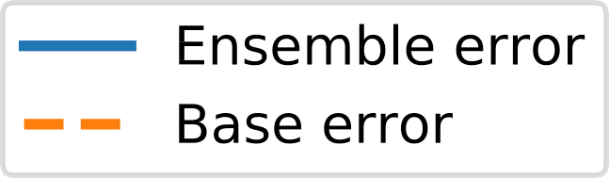



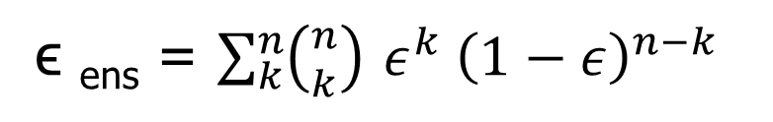
ϵ _{ens} = $\sum_{k}^{n}{\left({n \atop k}\right) ε^{k} {\left(1−ε\right)}^{n−k} }$
Sebastian Raschka

Slide 21
"Soft" Voting
n
ŷ = arg max w
∑
p
i i,j
j
i=1
^{p}i,j :
w_{j} :
predicted class membership probability of the ith classifier for class label j
optional weighting parameter, default
w_{i} = 1/n, ∀w_{i} ∈ {w₁, . . . , w_{n}}
Sebastian Raschka
21

Slide 22
"Soft" Voting
Use only for well-calibrated classifiers!
n
ŷ = arg max w
∑
i ^{p}i,j
j
i=1
^{p}i,j :
w_{j} :
predicted class membership probability of the ith classifier for class label j
optional weighting parameter, default
w_{i} = 1/n, ∀w_{i} ∈ {w₁, . . . , w_{n}}
Sebastian Raschka
22

Slide 23
"Soft" Voting
n
∑
ŷ = arg max w p
j
i i,j
i=1
Binary classification example
j ∈ {0,1}
h_{i} (i ∈ {1,2,3})
h₁(x) → [0.9,0.1]
h₂(x) → [0.8,0.2]
h₃(x) → [0.4,0.6]
Sebastian Raschka
18

Slide 24
"Soft" Voting
n
ŷ = arg max
∑
w p
i i,j
j
i=1
Binary classification example
j ∈ {0,1} h_{i}(i ∈ {1,2,3})
h₁(x) → [0.9,0.1]
h₂(x) → [0.8,0.2]
h₃(x) → [0.4,0.6]
p( j = 0 | x) = 0.2 ⋅ 0.9 + 0.2 ⋅ 0.8 + 0.6 ⋅ 0.4 = 0.58
p( j = 1 | x) = 0.2 ⋅ 0.1 + 0.2 ⋅ 0.2 + 0.6 ⋅ 0.6 = 0.42
ŷ = arg max p( j = 0 | x), p( j = 1 | x)
{ }
j
Sebastian Raschka
24

Slide 25
Types of Ensemble Methods
Manipulate data distribution
Example: bagging, boosting
Manipulate input features
Example: random forests

Slide 26
Bagging (Bootstrap Aggregating)
Technique uses these subsets (bags) to get a fair idea of the distribution (complete set).
The size of subsets created for bagging may be less than the original set.
Bootstrapping is a sampling technique in which we create subsets of observations from the original dataset, with replacement.
When you sample with replacement, items are independent. One item does not affect the outcome of the other. You have 1/7 chance of choosing the first item and a 1/7 chance of choosing the second item.
If the two items are dependent, or linked to each other. When you choose the first item, you have a 1/7 probability of picking a item. Assuming you don’t replace the item, you only have six items to pick from. That gives you a 1/6 chance of choosing a second item.

Slide 27
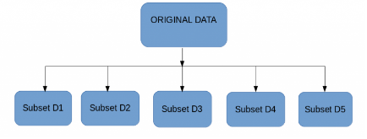
Bagging
Multiple subsets are created from the original dataset, selecting observations with replacement.
A base model (weak model) is created on each of these subsets.
The models run in parallel and are independent of each other.
The final predictions are determined by combining the predictions from all the models.

Slide 28
Bagging Example
Consider 1-dimensional data set:
Classifier is a decision stump
Decision rule: x ≤ k versus x > k
Split point k is chosen based on entropy
x ≤ k
True
False
y_{left}
y_{right}

Slide 29
Bagging Example
X < = 0.01 -> y= -1
X > 0.01 -> y= 1

Slide 30
Bagging Example

Slide 31
Bagging Example
Summary of Training sets:

Slide 32
Bagging Example
Assume test set is the same as the original data
Use majority vote to determine class of ensemble classifier
Predicted Class

Slide 33
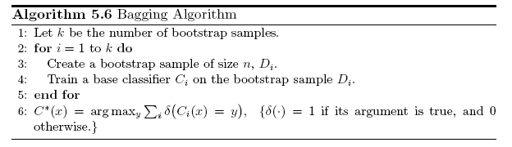
Bagging Algorithm

Slide 34
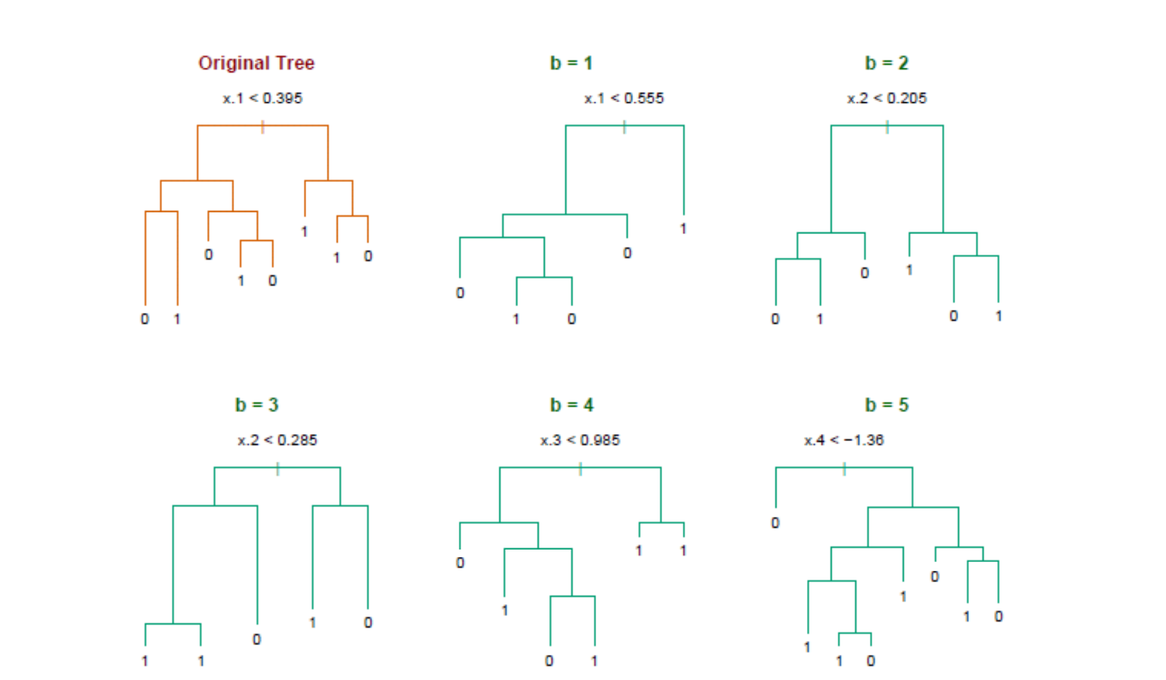
Bagging decision trees
Hastie et al.,”The Elements of Statistical Learning: Data Mining, Inference, and Prediction”, Springer (2009)

Slide 35
Out-of-Bag Error Estimation
No cross validation?
Remember, in bootstrapping we sample with replacement, and therefore not all observations are used for each bootstrap sample. On average 1/3 of them are not used!
We call them out-of-bag samples (OOB)
We can predict the response for the i-th observation using each of the trees in which that observation was OOB and do this for n observations
Calculate overall OOB MSE or classification error
Notes:
equivalent to leave-one-out cross-validation error
1/N to choose, 1-1/N not to choose, (1-1/N)N and (1-1/N) 1-(1-1/N)N 1-e^(-1)

Slide 36
Bagging
Reduces overfitting (variance)
Normally uses one type of classifier
Decision trees are popular
Easy to parallelize

Slide 37
Variable Importance Measures
Bagging results in improved accuracy over prediction using a single tree
Unfortunately, difficult to interpret the resulting model. Bagging improves prediction accuracy at the expense of interpretability.
Calculate the total amount that the RSS or entropy is decreased due to splits over a given predictor, averaged over all B trees.

Slide 38
Using Gini index on heart data
Notes:
A variable importance plot for the Heart data. Variable importance is computed using the mean decrease in Gini index, and expressed relative to the maximum.

Slide 39
Bagging - issues
Each tree is identically distributed (i.d.)
➔ the expectation of the average of B such trees is the same as the expectation of any one of them
the bias of bagged trees is the same as that of the individual trees
i.d. and not i.i.d

Slide 40
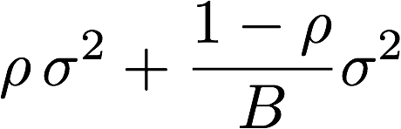
Bagging - issues
An average of B i.i.d. random variables, each with variance σ², has variance: σ²/B
If i.d. (identical but not independent) and pair correlation ρ is present, then the variance is:
As B increases the second term disappears but the first term remains
Why does bagging generate correlated trees?

Slide 41
Bagging - issues
Suppose that there is one very strong predictor in the data set, along with a number of other moderately strong predictors.
Then all bagged trees will select the strong predictor at the top of the tree and therefore all trees will look similar.
How do we avoid this?

Slide 42
Bagging - issues
We can penalize the splitting (like in pruning) with a penalty term that depends on the number of times a predictor is selected at a given length
We can restrict how many times a predictor can be used
We only allow a certain number of predictors
NO THE SAME BIAS
NO THE SAME BIAS
NO THE SAME BIAS

Slide 43
Bagging - issues
Remember we want i.i.d such as the bias to be the same and variance to be less?
Other ideas?
What if we consider only a subset of the predictors at each split?
We will still get correlated trees unless ….
we randomly select the subset !

Slide 44
Boosting
What if a data point is incorrectly predicted by the first model, and then the next (probably all models), will combining the predictions provide better results? Such situations are taken care of by boosting.
Boosting is a sequential process, where each subsequent model attempts to correct the errors of the previous model.
The succeeding models are dependent on the previous model.

Slide 45
Boosting
An iterative procedure to adaptively change distribution of training data by focusing more on previously misclassified records
Initially, all N records are assigned equal weights
Unlike bagging, weights may change at the end of each boosting round

Slide 46
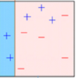
Boosting
A subset is created from the original dataset.
Initially, all data points are given equal weights.
A base model is created on this subset.
This model is used to make predictions on the whole dataset.

Slide 47
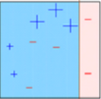
Boosting
Errors are calculated using the actual values and predicted values.
The observations which are incorrectly predicted, are given higher weights. (Here, the three misclassified blue-plus points will be given higher weights)
Another model is created and predictions are made on the dataset. (This model tries to correct the errors from the previous model)

Slide 48
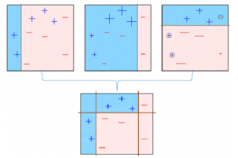
Boosting
Similarly, multiple models are created, each correcting the errors of the previous model.
The final model (strong learner) is the weighted mean of all the models (weak learners).
Individual models would not perform well on the entire dataset, but they work well for some part of the dataset. Thus, each model actually boosts the performance of the ensemble.

Slide 49
Algorithms based on Bagging and Boosting
Bagging algorithms:
Random forest
Boosting algorithms:
AdaBoost
Gradient Boosting

Slide 50
Random Forest
Random Forest is ensemble machine learning algorithm that follows the bagging technique.
The base estimators in random forest are decision trees.
Random forest randomly selects a set of features which are used to decide the best split at each node of the decision tree.

Slide 51
Random Forest
Random subsets are created from the original dataset (bootstrapping).
At each node in the decision tree, only a random set of features are considered to decide the best split.
A decision tree model is fitted on each of the subsets.
The final prediction is calculated by averaging the predictions from all decision trees.

Slide 52
Random Forests Algorithm
For b = 1 to B:
Draw a bootstrap sample Z∗ of size N from the training data.
(b) Grow a random-forest tree to the bootstrapped data, by recursively repeating the following steps for each terminal node of the tree, until the minimum node size n_{min} is reached.
i. Select m variables at random from the p variables.
ii. Pick the best variable/split-point among the m.
iii. Split the node into two daughter nodes.
Output the ensemble of trees.
To make a prediction at a new point x we do:
For regression: average the results
For classification: majority vote

Slide 53
Random Forests Tuning
The inventors make the following recommendations:
For classification, the default value for m is √p and the minimum node size is one.
For regression, the default value for m is p/3 and the minimum node size is five.
In practice the best values for these parameters will depend on the problem, and they should be treated as tuning parameters.
Like with Bagging, we can use OOB and therefore RF can be fit in one sequence, with cross-validation being performed along the way. Once the OOB error stabilizes, the training can be terminated.

Slide 54
Advantages of Random Forest
Algorithm can solve both type of problems i.e. classification and regression
Power to handle large data set with higher dimensionality.
It can handle thousands of input variables and identify most significant variables so it is considered as one of the dimensionality reduction methods.
Model outputs Importance of variable, which can be a very handy feature (on some random data set).

Slide 55
RF: Variable Importance Measures
Record the prediction accuracy on the oob samples for each tree
Randomly permute the data for column j in the oob samples the record the accuracy again.
The decrease in accuracy as a result of this permuting is averaged over all trees, and is used as a measure of the importance of variable j in the random forest.

Slide 56
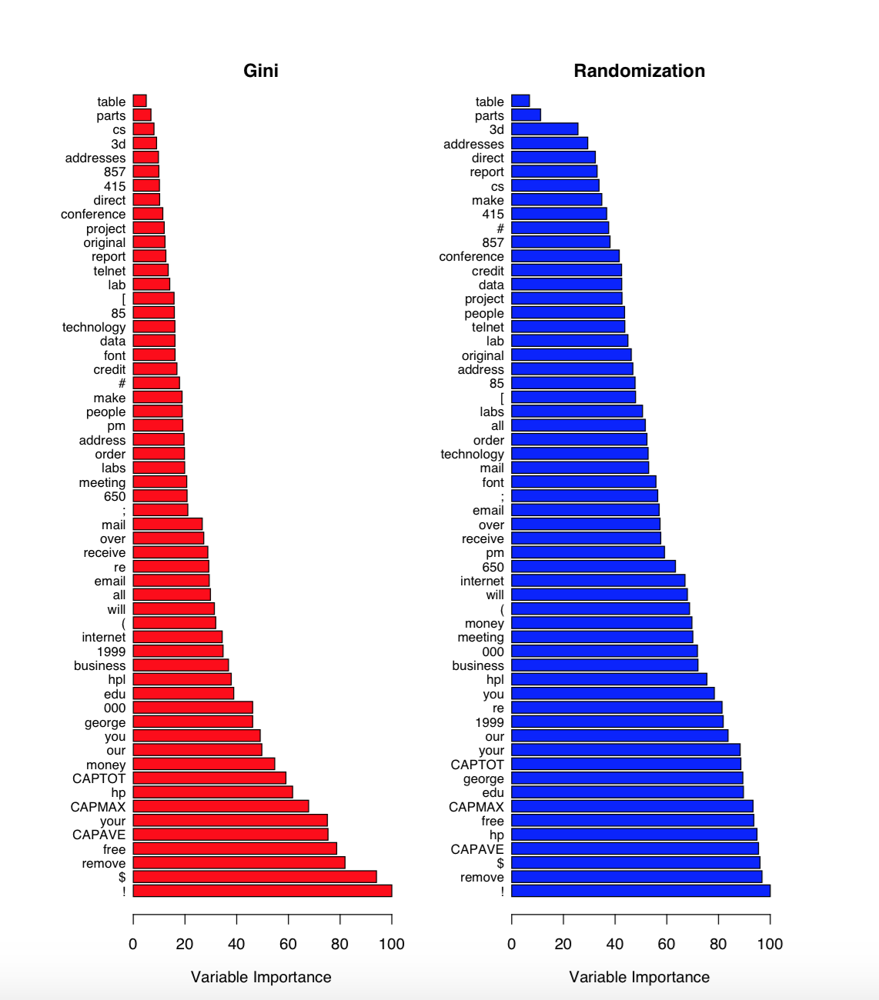

Slide 57
Disadvantages of Random Forest
May over-fit data sets that are particularly noisy.
Random Forest can feel like a black box approach for statistical modelers – you have very little control on what the model does. You can at best – try different parameters and random seeds!

Slide 58
Random Forests
As in bagging, we build a number of decision trees on bootstrapped training samples each time a split in a tree is considered, a random sample of m predictors is chosen as split candidates from the full set of p predictors.
Note that if m = p, then this is bagging.

Slide 59
Random Forests
Random forests are popular. Leo Breiman’s and Adele Cutler maintains a random forest website where the software is freely available, and of course it is included in every ML/STAT package
http://www.stat.berkeley.edu/~breiman/RandomForests/

Slide 60
Example
4,718 genes measured on tissue samples from 349 patients.
Each gene has different expression
Each of the patient samples has a qualitative label with 15 different levels: either normal or 1 of 14 different types of cancer.
Use random forests to predict cancer type based on the 500 genes that have the largest variance in the training set.
Notes:
There are around 20,000 genes in humans , and individual genes
23 chromosomes (2 x )

Slide 62
Random Forests Issues
When the number of variables is large, but the fraction of relevant variables is small, random forests are likely to perform poorly when m is small
Why?
Because:
At each split the chance can be small that the relevant variables will be selected
For example, with 3 relevant and 100 not so relevant variables the probability of any of the relevant variables being selected at any split is ~0.25

Slide 63
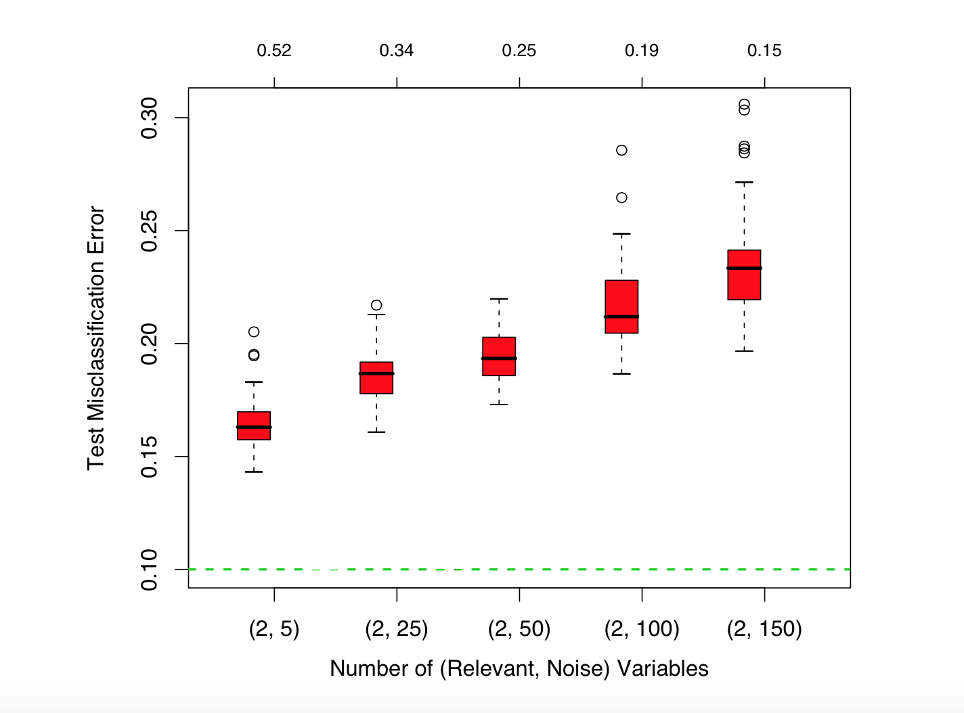
Probability of being selected

Slide 64
Can RF overfit?
Random forests “cannot overfit” the data wrt to number of trees.
Why?
The number of trees, B does not mean increase in the flexibility of the model

Slide 65
AdaBoost
Adaptive boosting or AdaBoost is one of the simplest boosting algorithms. Usually, decision trees are used for modelling. Multiple sequential models are created, each correcting the errors from the last model.
AdaBoost assigns weights to the observations which are incorrectly predicted and the subsequent model works to predict these values correctly.

Slide 66
AdaBoost Algorithm
Initially, all observations (n) in the dataset are given equal weights (1/n).
A model is built on a subset of data.
Using this model, predictions are made on the whole dataset.
Errors are calculated by comparing the predictions and actual values.
While creating the next model, higher weights are given to the data points which were predicted incorrectly.

Slide 67
Adaboost Algorithm
Weights can be determined using the error value. For instance, higher the error more is the weight assigned to the observation.
This process is repeated until the error function does not change, or the maximum limit of the number of estimators is reached.

Slide 68
AdaBoost
Base classifiers C_{i}: C₁, C₂, …, C_{T}
Error rate:
N input samples
Importance of a classifier:
https://en.wikipedia.org/wiki/AdaBoost#Choosing_αt

Slide 69
AdaBoost: Weight Update
Weight Update:
<- Eqn:5.88
Reduce weight if correctly classified else increase
If any intermediate rounds produce error rate higher than 50%, the weights are reverted back to 1/n and the resampling procedure is repeated

Slide 70
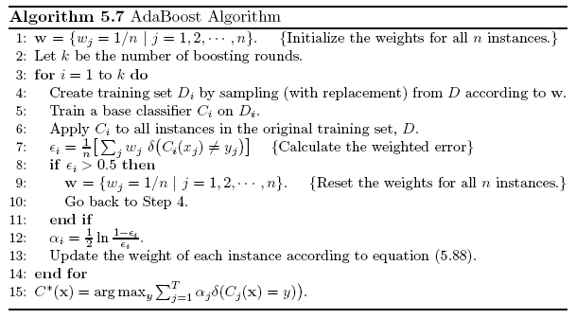
AdaBoost Algorithm

Slide 71
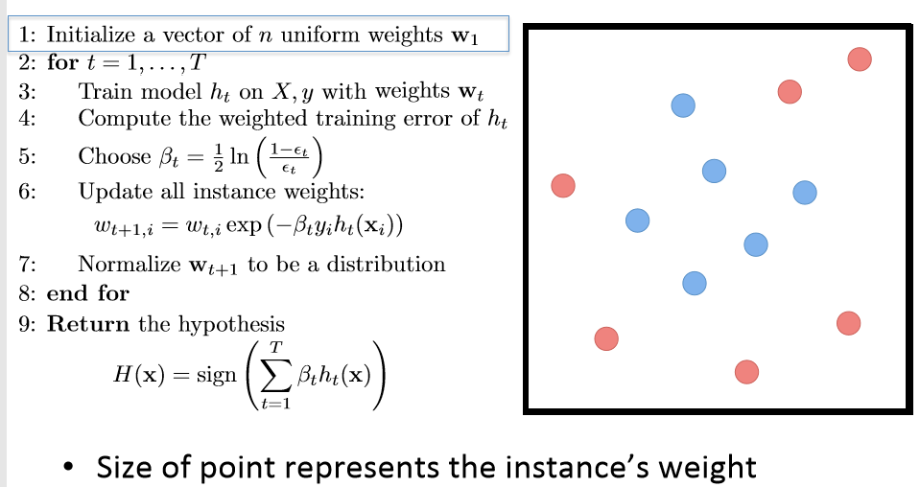
AdaBoost Algorithm
$$α in earlier slide same as β=weight of class$$

Slide 72
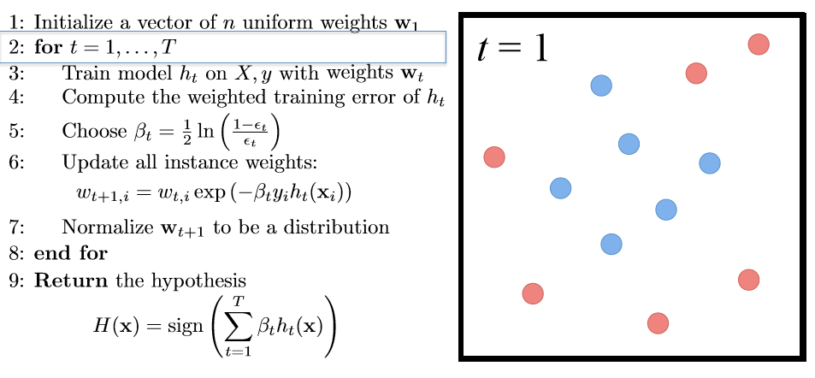
AdaBoost Algorithm

Slide 73
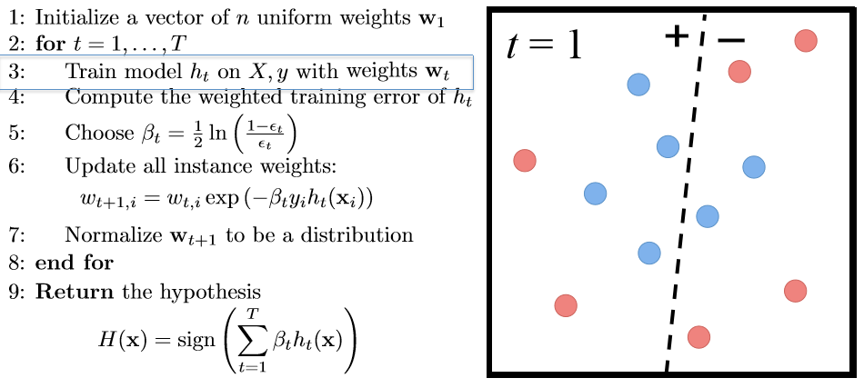
AdaBoost Algorithm

Slide 74
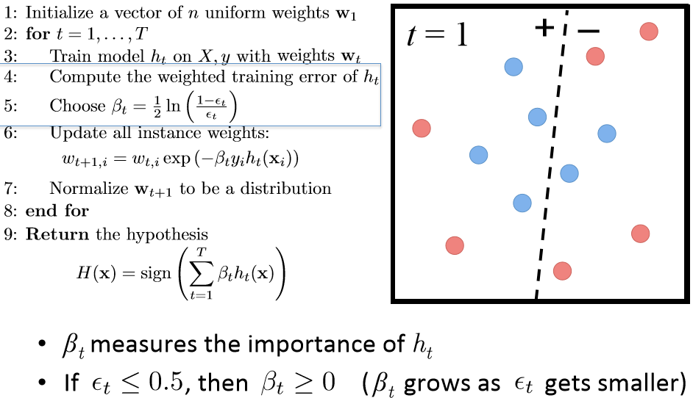
AdaBoost Algorithm

Slide 75
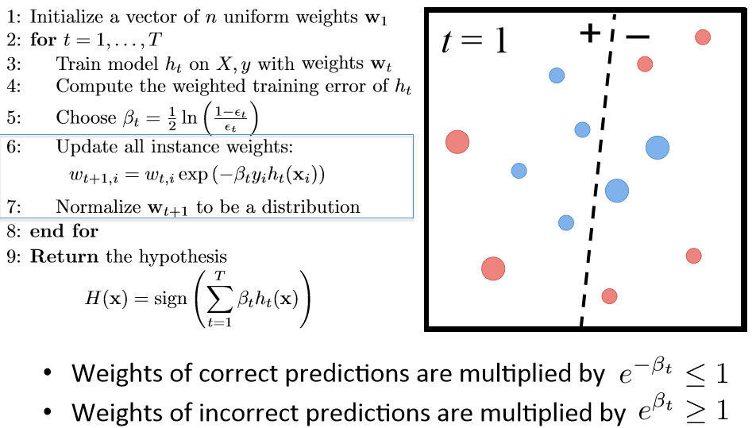
AdaBoost Algorithm

Slide 76
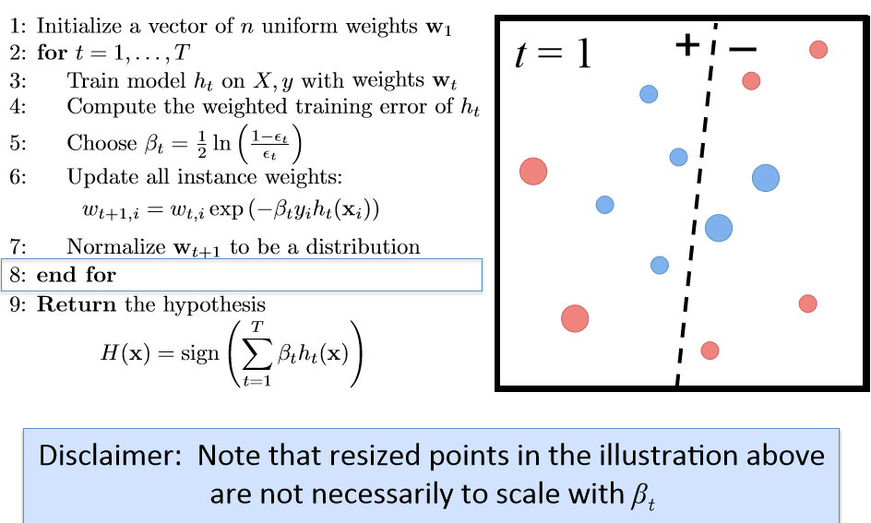
AdaBoost Algorithm

Slide 77
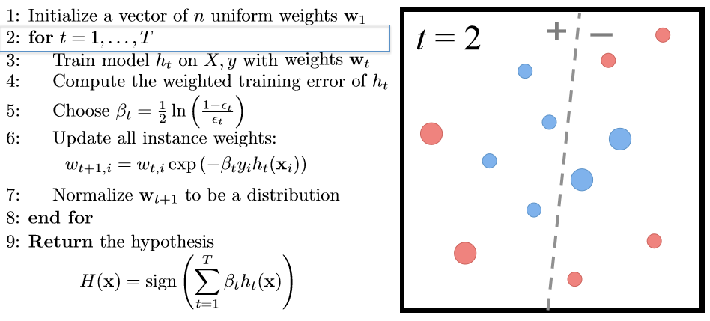
AdaBoost Algorithm

Slide 78
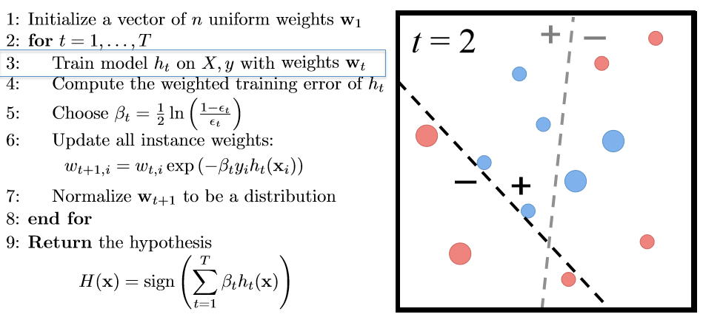
AdaBoost Algorithm

Slide 79
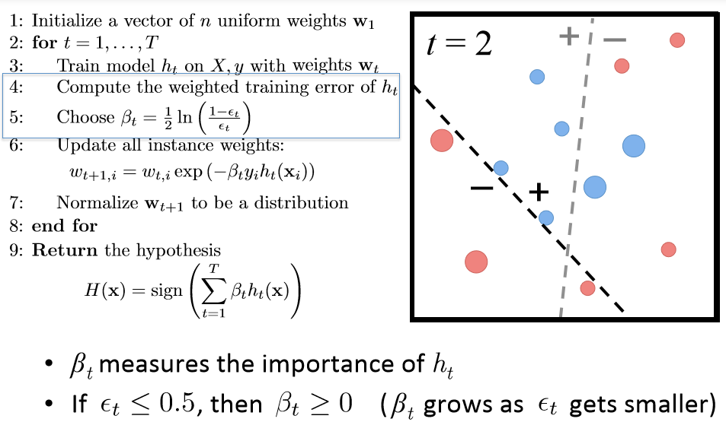
AdaBoost Algorithm

Slide 80
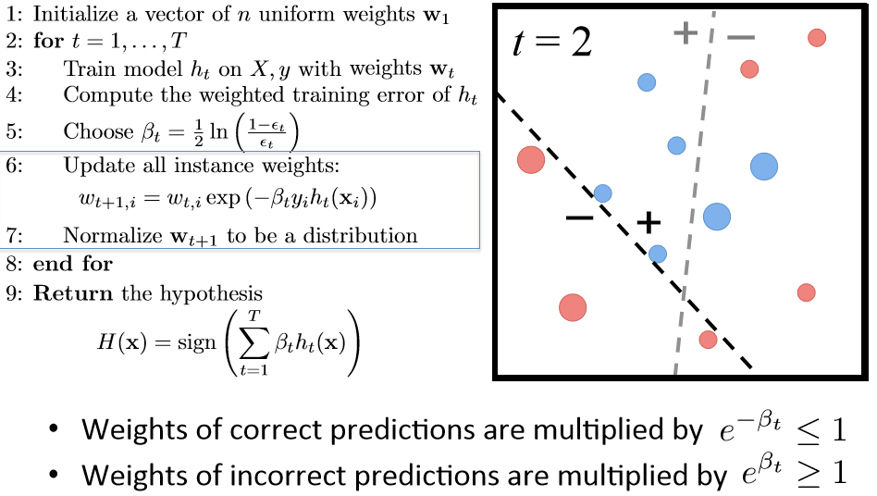
AdaBoost Algorithm

Slide 81
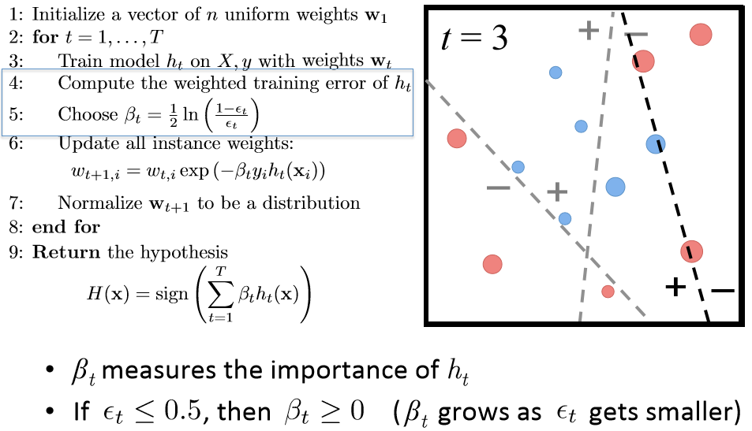
AdaBoost Algorithm

Slide 82
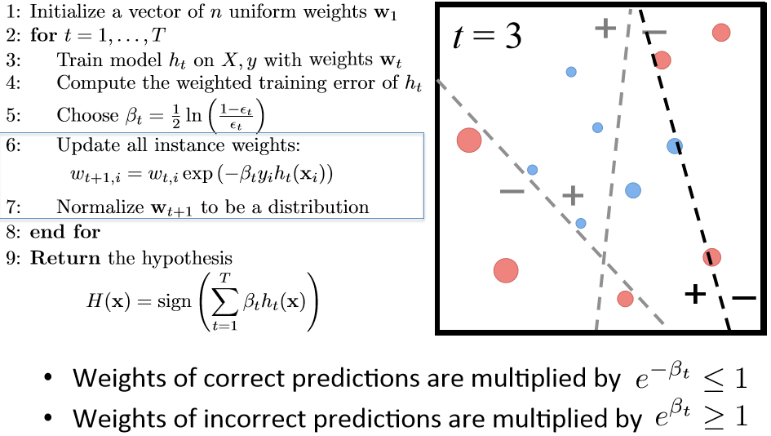
AdaBoost Algorithm

Slide 83
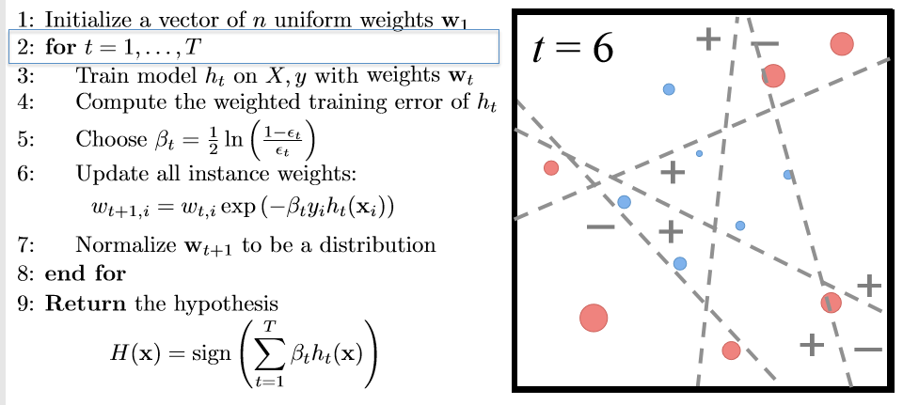
AdaBoost Algorithm

Slide 84
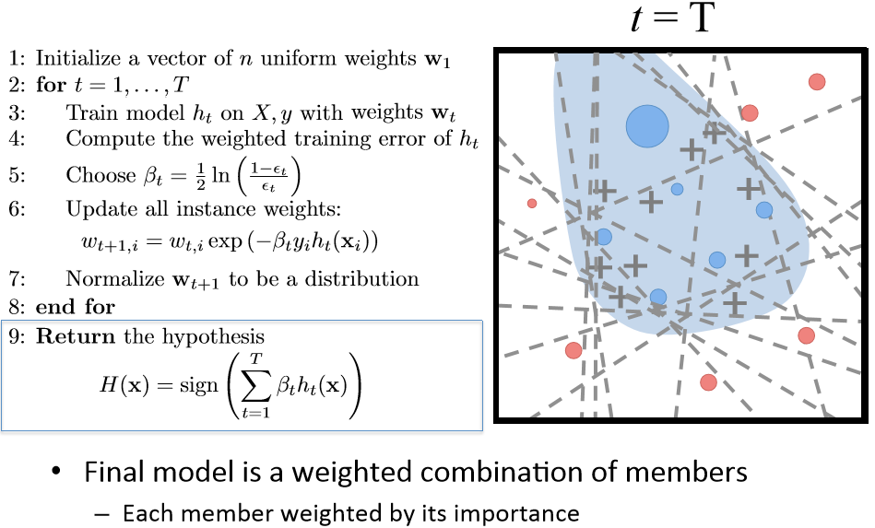
AdaBoost Algorithm

Slide 85
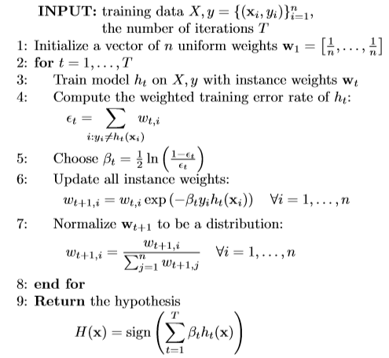
AdaBoost Algorithm
Member classifier with less error are given more weight in ﬁnal ensemble hypothesis. Final prediction is a weighted combination of each members prediction

Slide 86
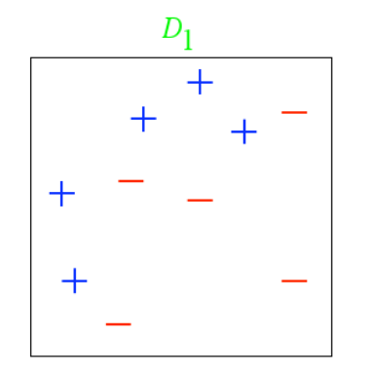
Example
From, L ́eon Bottou

Slide 87
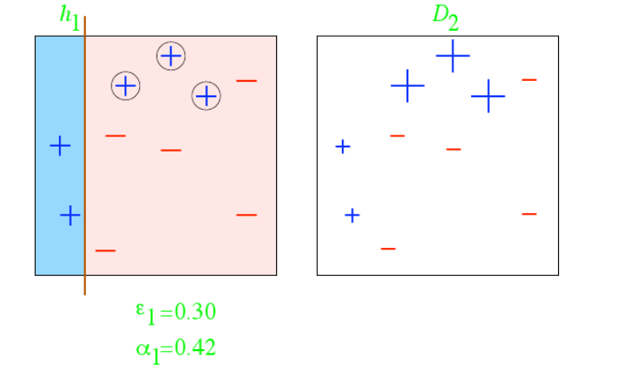
Example
From, L ́eon Bottou

Slide 88
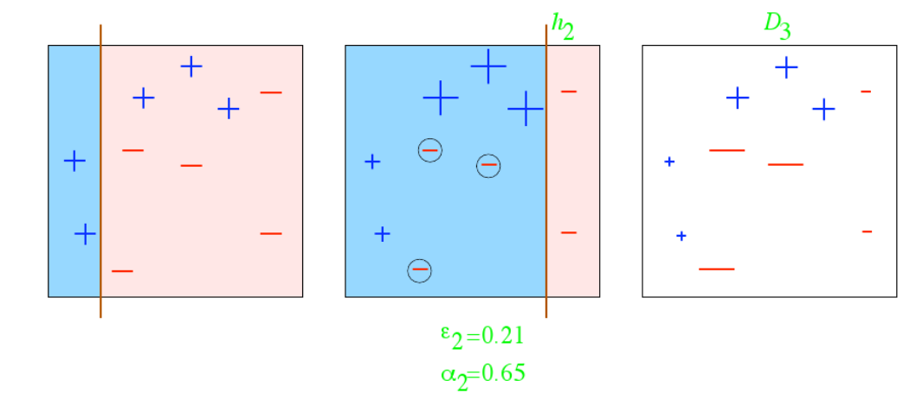
Example
From, L ́eon Bottou

Slide 89
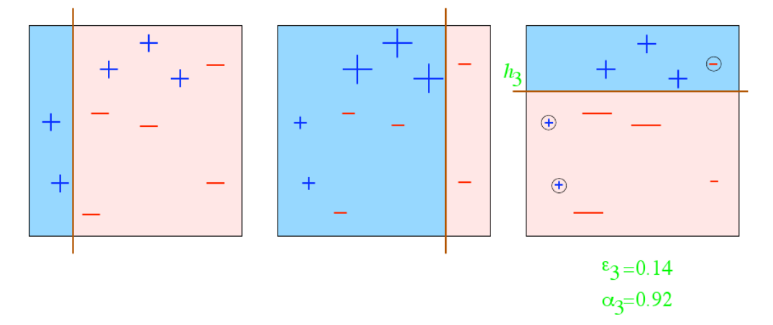
Example
From, L ́eon Bottou

Slide 90
Example
From, L ́eon Bottou

Slide 91
Example
How do we combine the results now?
From, L ́eon Bottou

Slide 92
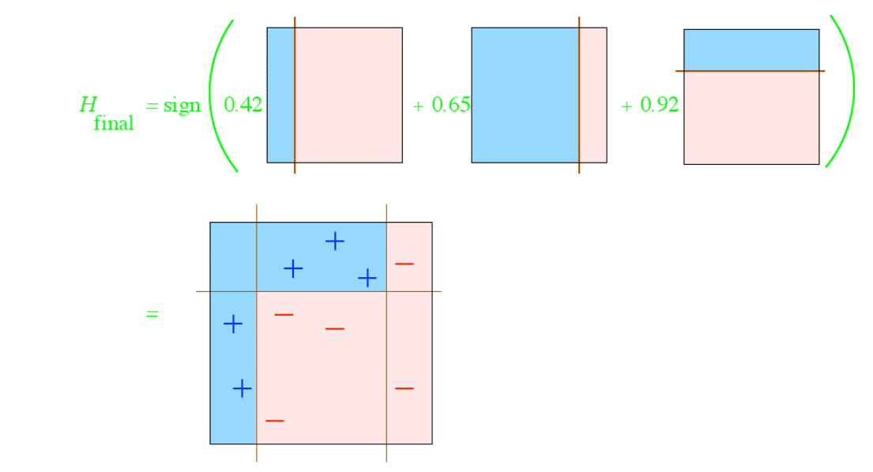
Example
How do we combine the results now?
From, L ́eon Bottou

Slide 93
AdaBoost Example
Training sets for the first 3 boosting rounds:
Summary:

Slide 94
AdaBoost Example
Weights
Classification
Predicted Class
AdaBoost error function takes into account the fact that only the sign of the final result is used, thus sum can be far larger than 1 without increasing error

Slide 95
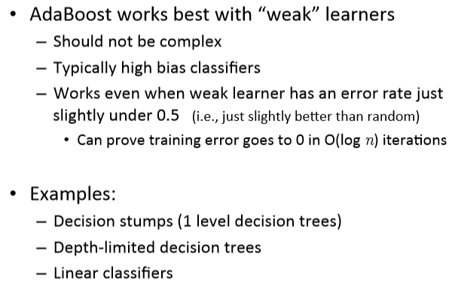
AdaBoost base learners

Slide 96
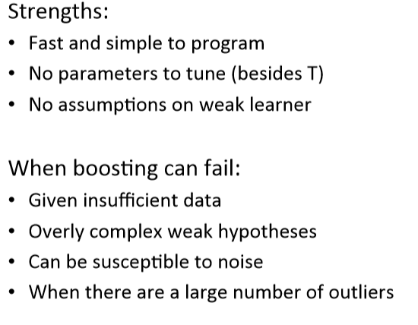
AdaBoost in practice

Slide 97
Fine Tuning Ensembles
Model combination does not always guaranteed to decrease error, unless
base-learners are diverse and accurate
Ignore poor base learners
Use accuracy as a cut-off
Introduce some pruning with which at each iteration remove poor learners / learners whose absence lead to improvement (if any)
Modify iterations to allow both additions / deletions of learners
Discarding appropriately leads to better performance

Slide 98
Gradient Boosting
In Gradient Boosting, "shortcomings” are identified by gradients.
Recall that, in Adaboost, “shortcomings” are identified by high-weight data points.
Both high-weight data points and gradients tell us how to improve our model.

Slide 99
Gradient Boosting
Gradient Boosting for Different Problems Difficulty: regression ===> classification ===> ranking

Slide 100
Gradient Boosting
You are given (x1, y1),(x2, y2), ...,(xn, yn), and the task is to fit a model F(x) to minimize square loss
There are some mistakes: F(x1) = 0.8, while y1 = 0.9, and F(x2) = 1.4 while y2 = 1.3... How can you improve this model?
Rules:
You are not allowed to remove anything from F or change any parameter in F.
You can add an additional model (regression tree) h to F, so the new prediction will be F(x) + h(x).

Slide 101
Gradient Boosting
You wish to improve the model such that
F(x1) + h(x1) = y1
F(x2) + h(x2) = y2 ...
F(xn) + h(xn) = yn
Or, equivalently, you wish
h(x1) = y1 − F(x1)
h(x2) = y2 − F(x2) ...
h(xn) = yn − F(xn)
Fit a regression tree h to data
(x1, y1 − F(x1)),(x2, y2 − F(x2)), ...,(xn, yn − F(xn))

Slide 102
Gradient Boosting
Simple solution: yi − F(xi) are called residuals. These are the parts that existing model F cannot do well.
The role of h is to compensate the shortcoming of existing model F.
If the new model F + h is still not satisfactory, we can add another regression tree...
We are improving the predictions of training data, is the procedure also useful for test data?

Slide 103
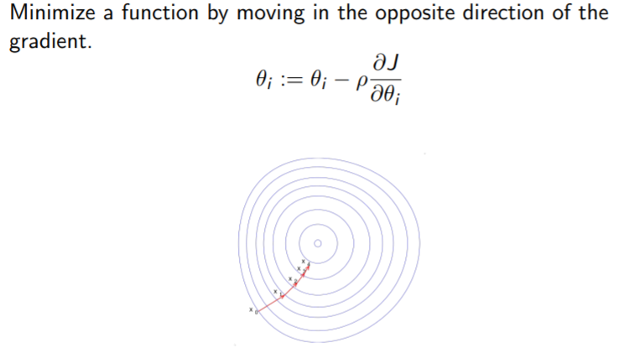
Gradient Descent

Slide 104
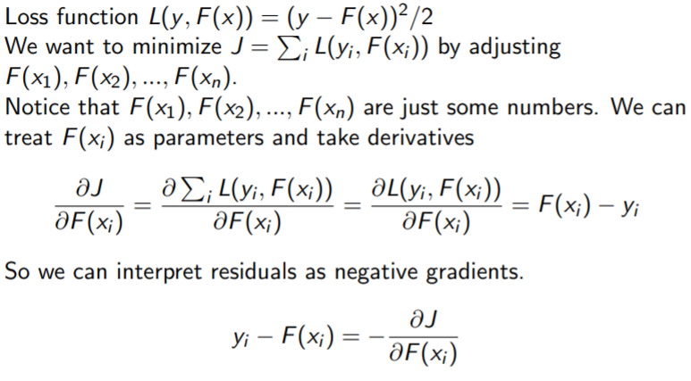
Gradient Boosting for regression

Slide 105
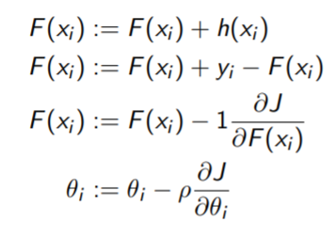
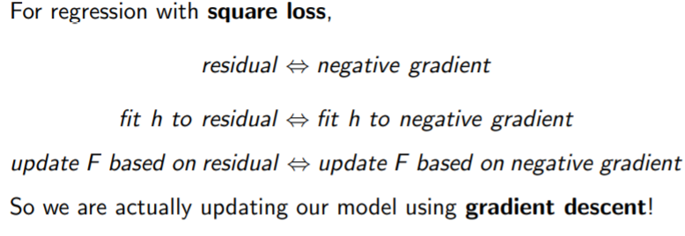

Slide 106
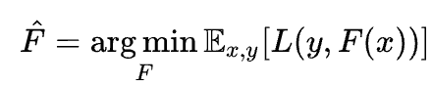
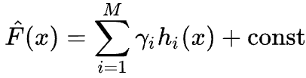

Gradient Boosting Algorithm
:
It involves three elements
A loss function to be optimized (minimizes expected value)
Approximation of F(x) in terms of weighted sum of base(weak) learners h_{i}(x) to make predictions
An additive model to minimize the loss function, starting with F₀(x) and incrementally expanding in greedy fashion

Slide 107
Why XGBoost so popular?
Speed : faster than other ensemble classifiers.
Core algorithm is parallelizable: harness the power of multi-core computers and networks of computers enabling to train on very large datasets Consistently outperforms other algorithm methods : It has shown better performance on a variety of machine learning benchmark datasets.
Wide variety of tuning parameters : cross-validation, regularization, missing values, tree parameters, etc
XGBoost (Extreme Gradient Boosting) uses the gradient boosting (GBM) framework at its core.

Slide 108
References
The-Morgan-Kaufmann-Series-in-Data-Management-Systems-Jiawei-Han-Micheline-Kamber-Jian-Pei-Data-Mining.-Concepts-and-Techniques-3rd-Edition-Morgan-Kaufmann-2011
Bishop - Pattern Recognition And Machine Learning - Springer 2006
A Gentle Introduction to Gradient Boosting
Cheng Li chengli@ccs.neu.edu College of Computer and Information Science Northeastern University
https://www.youtube.com/watch?time_continue=647&v=LsK-xG1cLYA&feature=emb_logo

Slide 109
Thank You!

